Slide 1








Developing Machine Learning and Supply Chain Application Using Taipy
Industry Capstone Program Final Presentation
Spring 2023
Our Team
Priestley
Fernades
Kavan
Patel
Kanika
Yadav
Zhaoyi Xu
Richeng
Zhang
Syed
Qaderie
Rahul
Sikinam
Prof.Alkis V.

Slide 2

Corporate Partner : Taipy
Taipy is developed and maintained by Avaiga

Slide 3
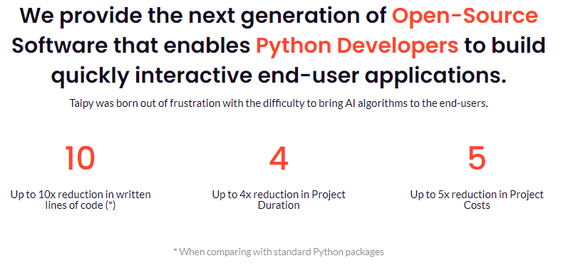
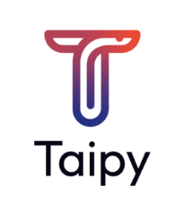

Slide 4
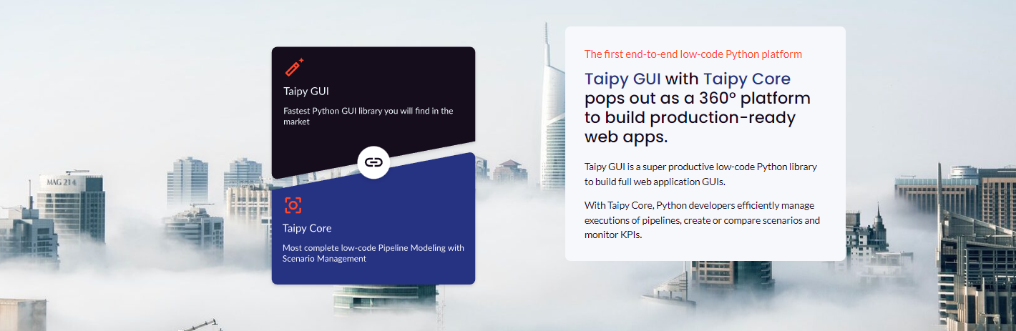
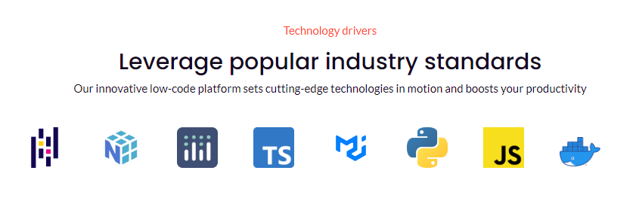

Slide 5
Build Taipy Projects for Smart Applications
1.Install & Create
Install Taipy using pip and create a new Taipy project by running a command in the terminal.
2.Build Interface
Create an interactive user interface using Taipy's drag and drop feature with a variety of widgets and components for your application.
3.Deploy Your App
Once you have built your application, deploy it to the web or cloud platform using the Taipy command-line interface. Taipy supports deployment to several platforms, including Heroku, AWS, and Google Cloud.

Slide 6
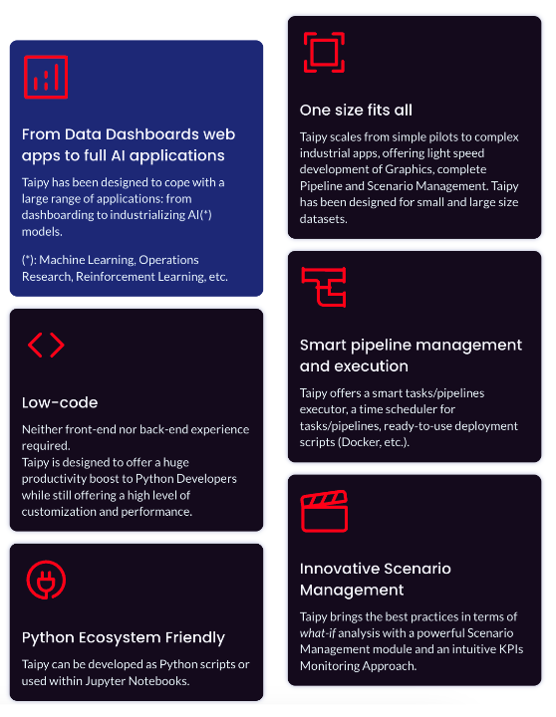
Taipy: The Missing Link Between Algorithms and End-Users
Taipy GUIs use web pages served by an app-hosted server.
Gui class manages server and displays pages with app status.
Users can interact with pages and trigger app code.
Pages use templates with placeholders for app data.
Taipy Core creates data-driven apps from Python algorithms.
Core uses DAGs for pipeline modelling, execution, and monitoring.
Pipelines can be simple or complex.

Slide 7
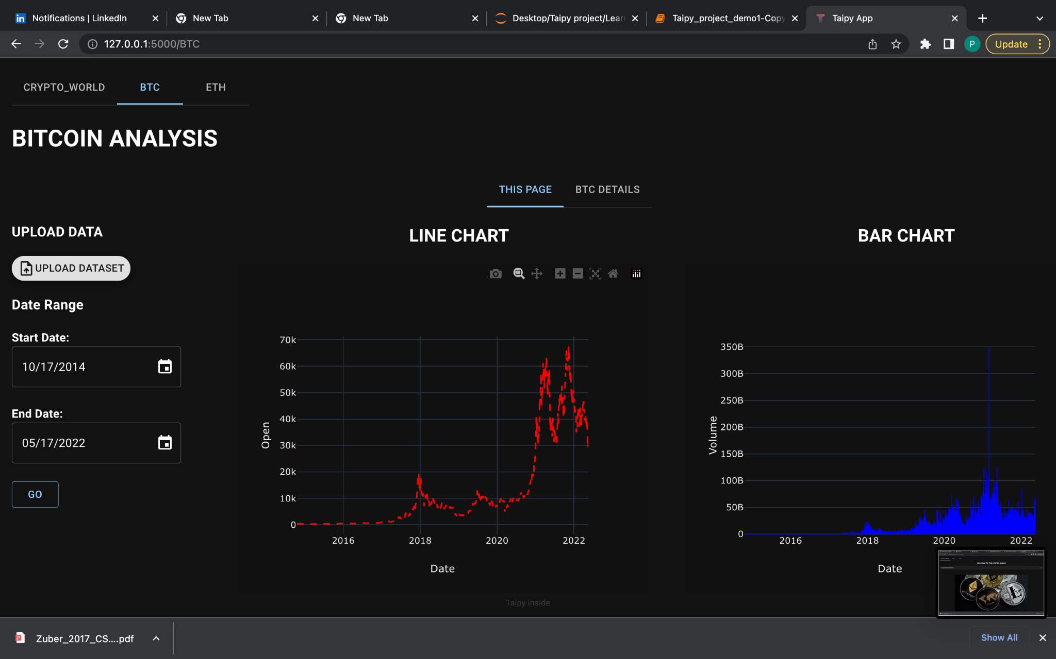
How did we start
Develop Smart Bitcoin Analysis with Taipy
Statistical Processing 📊
Perform statistical processing of Bitcoin using a Taipy Core pipeline.
Technical Analysis 📈
Perform technical analysis of Bitcoin using a Taipy Core pipeline.
User-Friendly Interface 🚀
Use Taipy GUIs to analyze Bitcoin trends and statistics with a user-friendly interface.

Slide 8
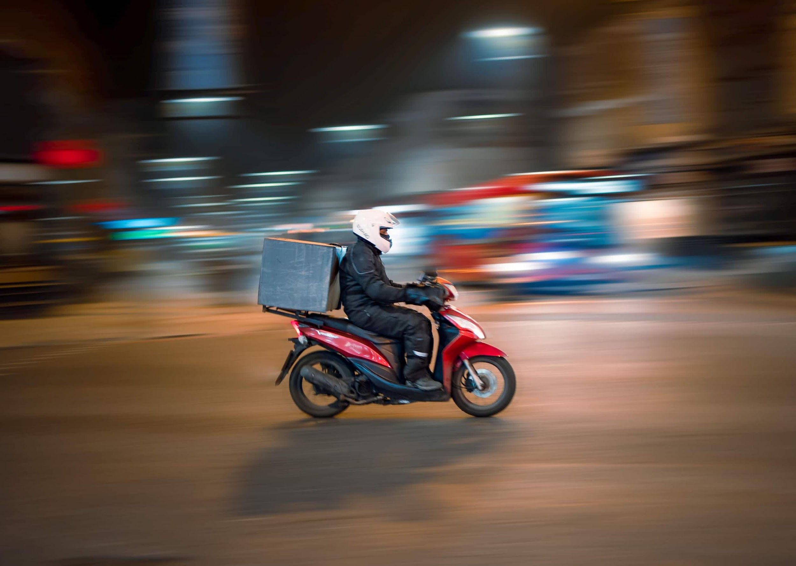
Goal
EDS
We integrated efficient delivery system using Google OR tools, Google API’s, and open route service API to build a optimization model.
Balancing Supply and Demand in Delivery Systems
Balancing supply and demand in delivery systems is crucial for customer and merchant satisfaction.
Shortages of drivers or orders can lead to dissatisfaction on both ends.
Efficient Delivery System Using Taipy
Delivery systems predict delivery times using factors like traffic and adjust prices/distance to balance supply/demand.
Dynamic pricing incentivizes drivers and customers during high and low demand periods..
Minimizing Disruptions, Flexibility enables quick adjustments
Enhance Customer Experience

Slide 9
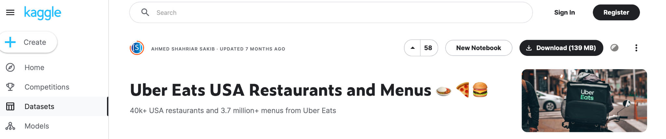
Dataset
About the Dataset
We sifted through different datasets to find Uber Eats partnered restaurants in the USA.
Searching
We spent time searching and filtering the dataset until we found what we were looking for.
Objective
The result was a dataset of restaurants and their menus.
Insights
We built a Map box-powered map to interface with the data and generate random orders and drivers.
https://www.kaggle.com/datasets/ahmedshahriarsakib/uber-eats-usa-restaurants-menus

Slide 10
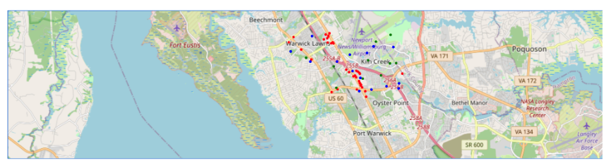
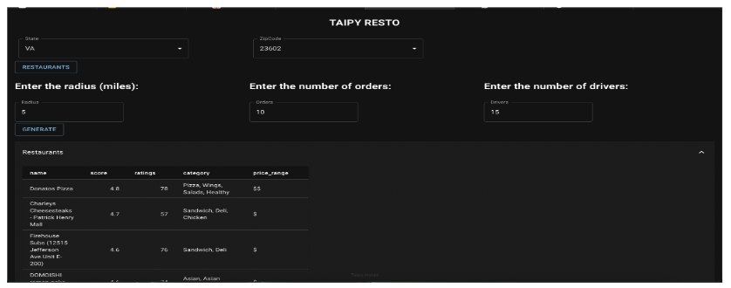
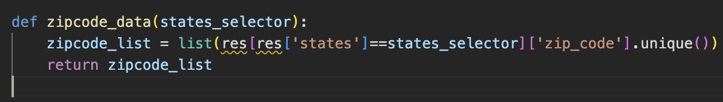
Generating Random Orders & Drivers
Features
We chose to use a box boundary instead of a radial selection and went ahead to generate random orders and drivers within the given radius of a zip code.
Validating Results
We had to filter out points in the sea or any unclear location as the orders will be located based on real-time customer and driver sharing.
Multiple Mappings
Several order-driver mappings were created based on delivery constraints and capacity optimization resulting in heatmap representations.

Slide 11

Challenges faced
Box Over Radial
Box boundaries offer compact and efficient areas, making map generation smoother with easy distance calculation.
Validating Mapped Points
Validating mapped points is crucial, and box boundaries improve efficiency.
Debugging the Code
To debug maps, tracking state variables with notify and small sample data is critical.
Visualization with Colored Coordinates
Visualizing coordinates with color enhances mapping comprehension. A bug in the latest version was fixed with partial implementation and downgrading to Taipy 2.0.0.
Real-Time Location Sharing
Sharing customer and driver locations generates efficient deliveries and happier customers.

Slide 12
For a single order (k) and driver (m) mapping, the algorithm assigns one driver to each order.
For multiple orders (k) and drivers (m), the algorithm is based on the following constraints:
Vehicle capacity
Assuming a capacity of 10, multiple orders can be assigned to a single driver if they can be delivered along a single route.
Pickup and delivery locations
Restaurants are the pick-up points and customers are the delivery locations. The algorithm randomly maps orders to drivers.
Number of vehicles
The algorithm creates equal or less routes based on the number of available vehicles.
Optimized routes
Assuming constant speed, the algorithm automatically optimizes the time for each route.
Based on these constraints, the algorithm returns the optimal mapping of orders and drivers.
Method for Mapping Drivers to Orders

Slide 13
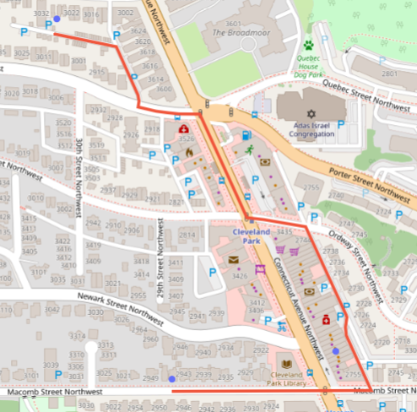
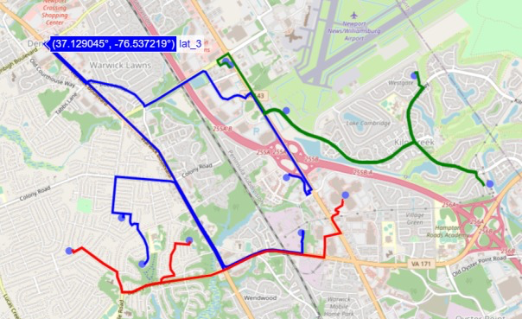
Single Order
Multiple Orders

Slide 14

Roadblocks
Driver Assignment:
1. Streamlined process for efficient driver assignment
2. Precise and reliable algorithm for accurate assignments
3. Leveraging Taipy components and visualization
EDS optimization:
1. Boundary analysis to define starting points
2. Optimized routes for timely delivery and reduced distance traveled
3. Dynamic assignments based on real-time factors.
4. Integrating the use cases with limited api access

Slide 15
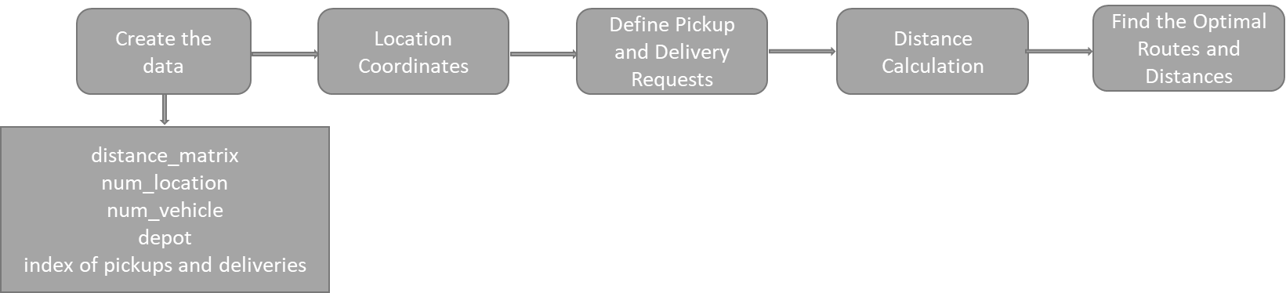
Workflow Changes with VRP
We look at how new VRP implementation has helped optimize our delivery routing.
Order Generation
Using a system for order generation and location identification to pinpoint positions of customers and restaurants.
Efficient Routing
Implementing a VRP-based routing model.
ML for Time Optimization
Optimizing time using ML models between the restaurant, customer and driver locations.

Slide 16
Introducing DeepRED by Door Dash
A new and advanced machine learning system offering state-of-the-art features to deliver food faster, easier and with less hassle.
Revolutionary Two-Layered System
Order Ready Model 👍
Allows drivers to choose delivery based on offered price, making it easier to optimize earnings.
Travel Time Model 🚗
Updates delivery routes considering ever-changing traffic conditions, thus reducing travel time, fuel and money.

Slide 17
Routing Algorithms
VRPTW
For time window constraints where customers are available only during specific times of the day.
CVRP
For capacitated vehicle routing problems with vehicles with limited carrying capacity and deliveries at various locations.
MVPDP
For assigning drivers to different orders and using VRP with pickups and deliveries algorithm to find the optimal routes.

Slide 18
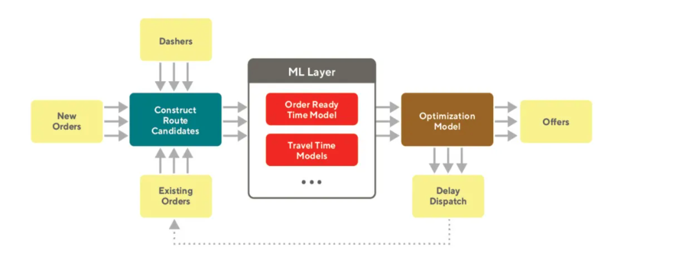
Maximizing Efficiency
Streamline your processes and get the most out of your resources.

Slide 19
An overview of our EDS system, designed to streamline the order generation and delivery process, while cutting down on costs.
Efficient Delivery System
Level 1: Order Generation & Location identification
Level 2: Efficient Routing & Delivery
Level 3: Machine Learning Integration

Slide 20
Optimized Routes
We visualized the optimized routes with the use of Google Map API.
Results
Reduced Make span
We minimized the time of delivery by using our efficient VRP algorithm.
Sequence of Orders Delivered
We assigned deliveries in sequence, which helps us maintain optimized routes.
Driver and Order Assignment
We optimized the sequence of assignments and used the shortest routes and available drivers.

Slide 21
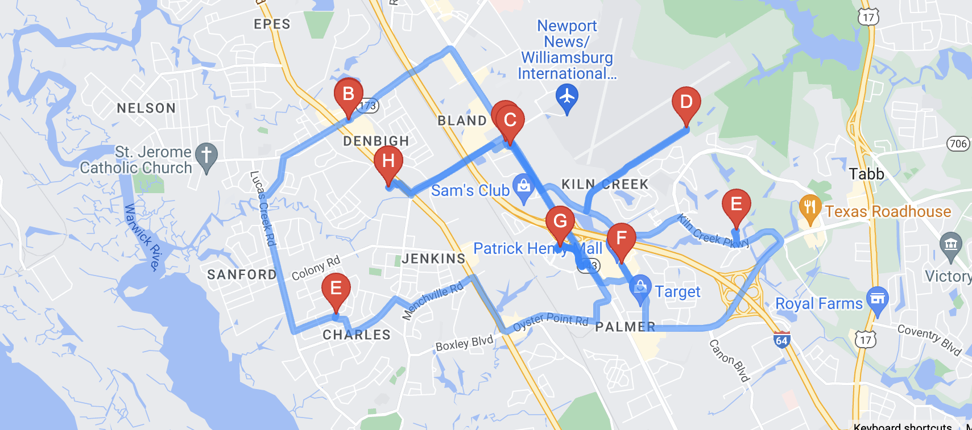
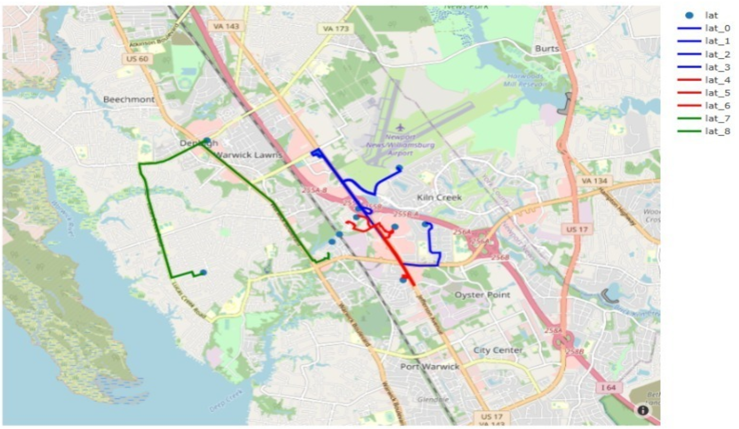
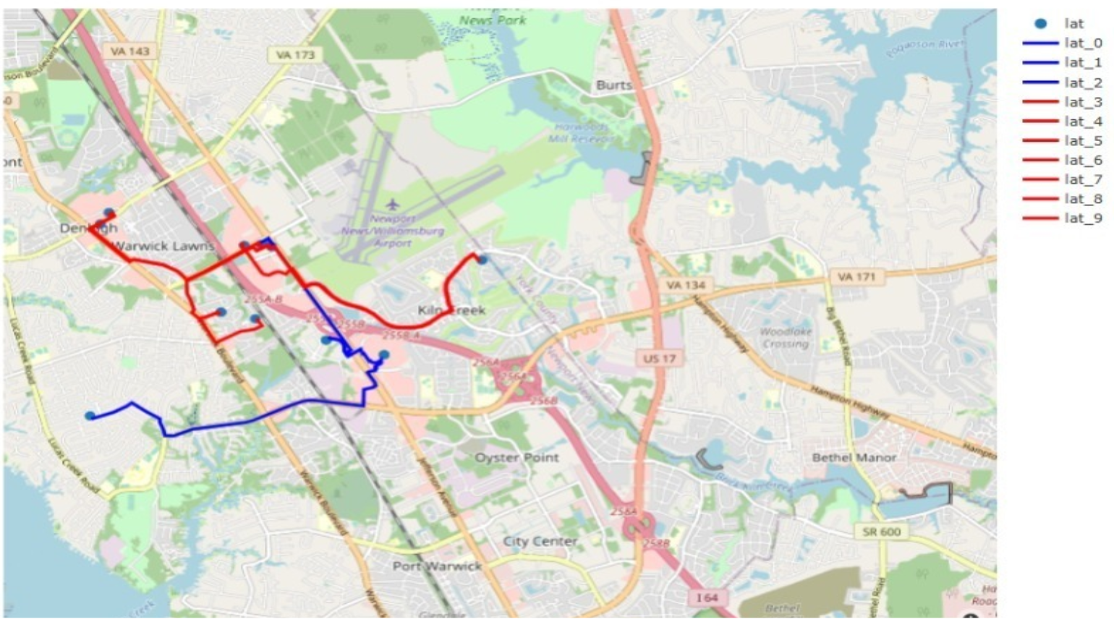
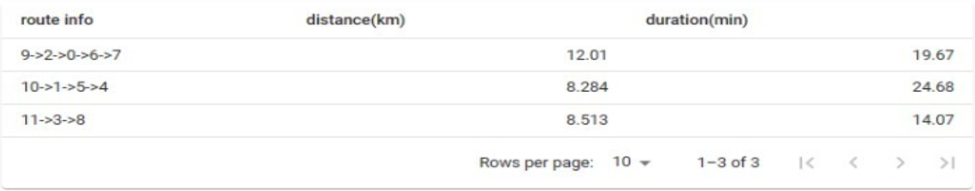
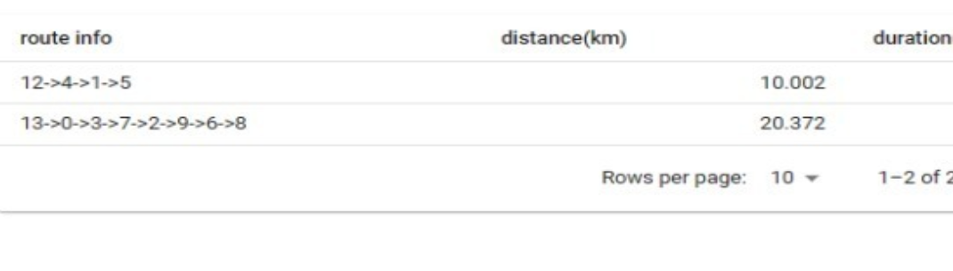
Plot of Routes
Case 1: Four Drivers, Five Orders and Four Restaurants → Two Routes
Case 2: Three Drivers, Five Orders and Four Restaurants → Three Routes

Slide 22
Effective and Efficient Way to Leverage Technology
We implemented our VRP model in a quick, effective, and efficient manner.
Conclusion
Routes Can Be Optimized
We can optimize routes based on the different types of numbers of drivers and optimized routes.
Use of Google APIs and Taipy Integration
The use of Google APIs and Taipy integration helped us succeed in the optimization of the VRP model within a short time frame.
Deliveries in Sequence
We maintained optimized routes by assigning deliveries in sequence, and successfully solving the VRP problem.

Slide 23
Feedback Loop
We plan to include a feedback loop that optimizes the next assignment of driver to an order.
Future Scope
Up-Scaling the Model Performance
We aim to scale up our model performance with large number of runs.
Addition of Critical Variables
We plan on including additional risk factors and critical variables for better efficiency.

Slide 24
https://doordash.engineering/2021/08/17/using-ml-and-optimization-to-solve-doordashs-dispatch-problem/
https://link.springer.com/chapter/10.1007/978-3-319-46307-0_29
https://developers.google.com/optimization
References

